Slide 1
Network Security - Assignment 4
Rupanshoo Saxena - 2019096
Saatvik Bhatnagar - 2019097

Slide 2
Project 1 - Digitally signed degree certificates:
Topic: Project 1 (A1 = 9096, A2 = 9097, k = (9096 + 9097) mod 3 = 1)
Project 1 : This application relates to building a web server that responds with a degree-certificate and grade-card whenever someone requests for it. The request must contain the graduate’s name & unique roll-number. The degree-certificate and grade-card (possibly in PDF format) is suitably digitally signed by the university authorities, together with the current (and correct) date & time.
How and where do you get the correct GMT date and time? Is the source reliable and the GMT date and time obtained in a secure manner?
How do you ensure that only the graduate is able to download it (by providing information beyond the roll no, such as date of birth, home pin code, etc.?
Should the graduate decide to share the document with others, how can one trace the origin of the document (could watermarks be useful?)?
Do we need to have access to public-keys, and if so how?
Bonus points if you address this issue: How do you get the document to be digitally signed by two persons (say the Registrar and the Director?)

Slide 3
Requirements:
Integrity of timing i.e. getting correct GMT date and time securely, making sure that the source is reliable → achieved using Cristian’s algorithm
Ensuring Confidentiality i.e. only the graduate is able to download it → achieved using Symmetric private-key cryptosystem.
Source/ origin of message i.e. tracing origin of the document must be possible → achieved by digitally signing the documents i.e. the non-repudiation property of digital signatures
Accessing public keys securely → Public keys will be accessed securely using a KDC securely.

Slide 4
Entities
The Client (Student side)
The Certificate Granting Server
The KDC
The Clock Server (provides synchronized process time)

Slide 5
Synchronized time - Cristian’s Algorithm
essential for maintaining integrity of timing - for getting correct GMT date and time securely and from a reliable source.
achieved using Cristian’s Algorithm
Cristian’s Algorithm is used to synchronize time using a clock time server. The algorithm follows the following formula:
T_{client} = T_{server} + (T₁ - T₀) / 2
Here,
T_{client} → the final synchronized time
T_{server} → clock time returned by the clock server
T₀ → the time at which the client sends the clock server a request
T₁ → the time at which the client receives the response sent by the clock server
Reference: https://www.geeksforgeeks.org/cristians-algorithm/

Slide 6
Establishing a connection between the degree-granting server and the student client
Student
Client (ID_{client})
<PU_{client} , PR_{client}>
Student
Client (ID_{client})
<PU_{client} , PR_{client}>
Handshake → [ID_{client} , PU_{client}]
Request → [ID_{client} , ID_{server}]
Response → [ID_{KDC} , PU_{KDC}]
KDC (ID_{KDC})
<PU_{KDC} , PR_{KDC}>
KDC (ID_{KDC})
<PU_{KDC} , PR_{KDC}>
Response → [ID_{KDC}, E(PU_{client}, [ID_{server,} PU_{server}])
Response → [ID_{KDC} , PU_{KDC}]
Degree - granting
Server (ID_{server})
<PU_{server} , PR_{server}>
Degree - granting
Server (ID_{server})
<PU_{server} , PR_{server}>
Handshake → [ID_{server} , PU_{server}]
Fig 1: Both parties carry out a handshake with the KDC and receive confirmation on their public keys being received and stored by the KDC
Fig 2. The student client requests the KDC for the degree server’s public key and receives requested information confidentially.

Slide 7
Requesting for Degree-certificate and Grade card
Student
Client (ID_{client})
<PU_{client} , PR_{client}>
Request:
{
name,
rollno,
password
}
name: name of the student whose degree we’re requesting from the server
rollno: unique roll number of the student
password: secret password that is used to authenticate the student.
Request → [ID_{client} , E(PU_{server}, [name, rollno, password])
Degree - granting
Server (ID_{server})
<PU_{server} , PR_{server}>
Fig 3. Degree server receives a request from the client and authenticates the student details

Slide 8
Sending Request from Student to Server
Student
Client (ID_{client})
<PU_{client} , PR_{client}>
PR_{K} → [ID_{server}, E(PU_{client}, [PR_{K}])
KDC (ID_{KDC})
<PU_{KDC} , PR_{KDC}>
Ack → [ID_{client}, E(PR_{K}, [name, rollno])
Response → [ID_{KDC}, E(PU_{server}, [ID _{client,} PU_{client}])
Degree - granting
Server (ID_{server})
<PU_{server} , PR_{server}>
Request → [ID_{server} , ID_{client} ]
Fig 4. Degree server verifies student, shares private symmetric key and receives acknowledgement from student

Slide 9
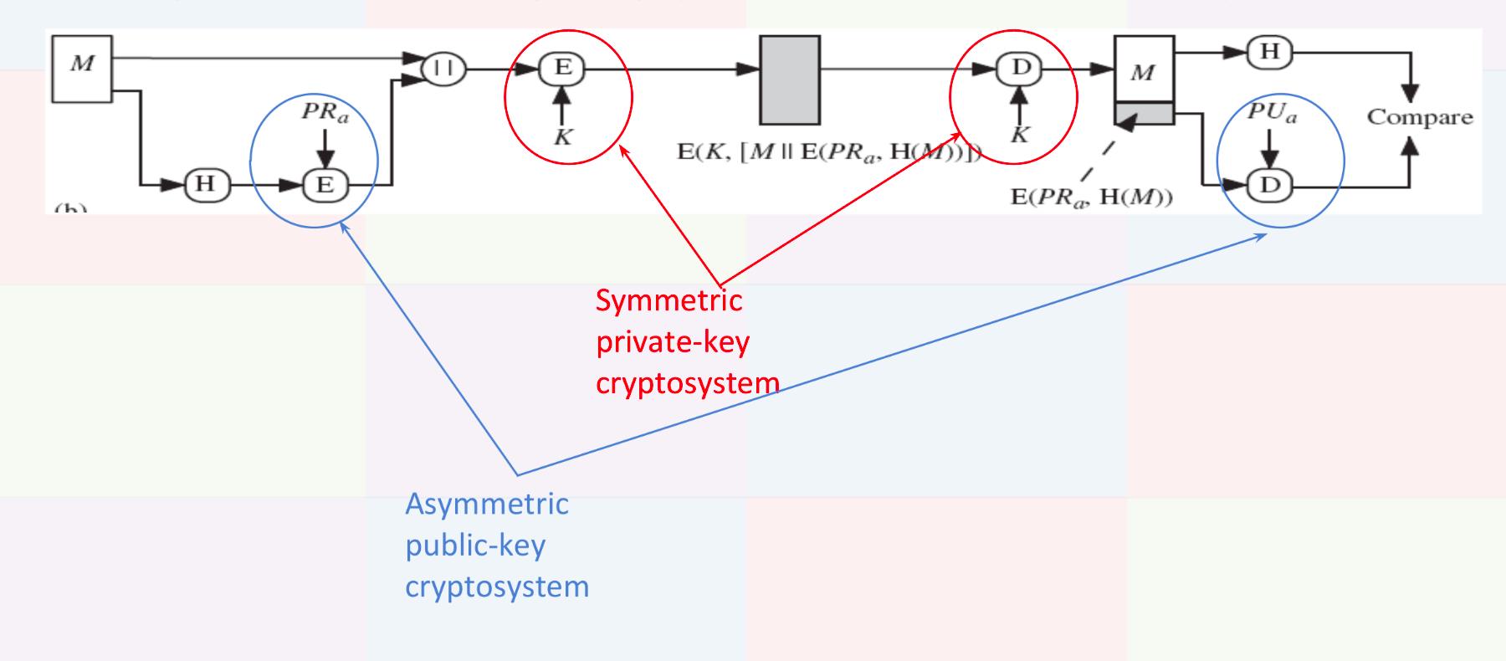
Basic Layout of Digital Signature Process

Slide 10
How and where do you get the correct GMT date and time? Is the source reliable and the GMT date and time obtained in a secure manner?
For each request that is carried out from any party, a timestamp is always a part of the request. Hence, instead of using an unreliable source, we use the Clock Server and calculate the synchronized time which gives us the correct GMT time and date in a secure manner and without latency. This synchronized time is then used as the timestamps and sent in requests which gives the synchronized time as to when request was sent.
This synchronized time is calculated using Cristian’s algorithm as discussed earlier.
1. Records T₀: sends request
Sends Request
Client
Clock Server
2. Receives request
Calculates T_{server}: time at which clock server received request
4. Receives T_{server}
5. Calculates T_{client}
3. Sends back T_{server}

Slide 11
2. How do you ensure that only the graduate is able to download it (by providing information beyond the roll no, such as date of birth, home pin code, etc.?
We ensure that only the intended student is able to download the degree certificate by encrypting the message using their private symmetric key K which ensures confidentiality and message integrity. This ensures that no one other than the student will be able to decrypt the file and hence won’t be able to access or download it. It also ensures that the file being received is authentic and hasn’t been tampered with. The source is trusted.

Slide 12
3. Should the graduate decide to share the document with others, how can one trace the origin of the document (could watermarks be useful?)?
Digital signature uses asymmetric public key cryptography which in turn ensures non-repudiation. When the sender creates a digital signature by signing using their private key, this can be verified by anyone else as it can be decrypted by the sender’s public key which is available publicly. Hence, it ensures that the sender cannot deny having sent the message and hence traces every message sent back to the sender. In this way, even if the student further shares the obtained degree certificate and grade card, it can be traced back to the sender. Any sort of changes to the file like another party adding a watermark etc would lead to the original file being changed and hence couldn’t be traced back to the sender, thus not being authentic.

Slide 13
4. Do we need to have access to public-keys, and if so how?
We require public keys. They are essential to establish a connection between the student client and the degree-granting server. We encrypt the messages being sent by them to each other using their public keys which ensures confidentiality of the messages being sent.
For eg. the messages being sent to the client from the server are encrypted using the client’s public key which the server obtained from the KDC. It is encrypted in this way so that only the client is able to decrypt it and ensure confidentiality.
All the public keys are available with the KDC (Key Distribution Centre) and all parties get access to other’s public keys by requesting the KDC. The KDC sends them the relevant information.
We have built a KDC to provide access to public keys.

